Slide 1


Slide 2
Chapter 4 IP Addresses
Network and Security Fundamentals

Slide 3
Objectives
Describe the purpose of Internet Protocol version four (IPv4) and Internet Protocol version six (IPv6) addresses
Identify classful and classless IPv4 addresses
Describe various address types such as multicast and broadcast
Describe the purpose of a subnet mask and Classless inter-domain routing (CIDR) notation

Slide 4

Chapter 4 –IP Addresses
What are IP Addresses ?
IP addresses are extremely important to Transmission Control Protocol/Internet Protocol (TCP/IP) networks because each device must be assigned a unique IP address in order to communicate

Slide 5

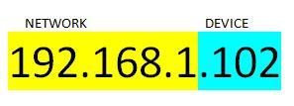
Chapter 4 –Network and Host
An IPv4 address is made up of four sets of eight binary digits, which are referred to as octets. Each IPv4 address is constructed of four octets containing 8 bits a piece. Therefore, an IPv4 address contains a total of 32 binary digits or bits.
128 | 64 | 32 | 16 | 8 | 4 | 2 | 1
8th bit | 7th bit | 6th bit | 5th bit | 4th bit | 3rd bit | 2nd bit | 1st bit
128 (2⁷) | 64 (2⁶) | 32 (2⁵) | 16 (2⁴) | 8 (2³) | 4 (2²) | 2 (2¹) | 1 (2⁰)

Slide 6
Chapter 4 Classes of IPv4 Addresses
IPv4 uses five classes of useable IP ranges: Class A, Class B, Class C, Class D, and Class E. Classes A to C are the most used on local-area networks (LANs)
CLASS | ADDRESS RANGE | AVAILABLE NETWORKS AND HOST
Class A | 1.0.0.1 to 126.255.255.254 | 16 million hosts on each of 127 networks
Class B | 128.1.0.1 to 191.255.255.254 | 65,000 hosts on each of 16,000
Class C | 192.0.1.1 to 223.255.254.254 | 254 hosts on each of two million networks
Class D | 224.0.0.0 to 239.255.255.255 | Reserved for multicast
Class E | 240.0.0.0 to 254.255.255.254 | Reserved for research and development
*The IP address 127.0.0.1 is called the loopback address and is reserved for testing the TCP/IP stack on the localhost.

Slide 7
Chapter 4 –IP Addresses, Subnet Mask, Slash Notation, Binary
Every IP address has an associated subnet mask. A subnet mask looks very similar to an IP address and is also 32 bits long. However, a subnet mask has a very different purpose than an IP address. A subnet mask in binary is a string of ones followed by zeros.
IP ADDRESS CLASS | DEFAULT SUBNET MASK | SLASH NOTATION | BINARY
Class A | 255.0.0.0 | /8 | 11111111.00000000.00000000.00000000
Class B | 255.255.0.0 | /16 | 11111111.11111111.00000000.00000000
Class C | 255.255.255.0 | /24 | 11111111.11111111.11111111.00000000

Slide 8
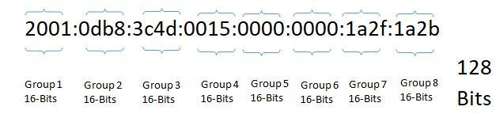
Chapter 4 –IP version 6 Addresses
IPv6 addresses use 128 bits. IPv6 addresses are also displayed using hexadecimal, which is quite different from the dotted decimal system used to write IPv4 addresses. This is important because hexadecimal numbers contain 4 bits, therefore an IPv6 address consist of 32 hexadecimal values.

Slide 9
Chapter 4 –Static and Dynamic IP addresses
Static IP addresses do not change and are consistent.
Dynamic IP addresses change periodically and are usually provided to network clients by a Dynamic Host Configuration Protocol server or router.

Slide 10
Chapter 4 –Public and Private IP addresses
Private IP Address Ranges
ADDRESS CLASS | ADDRESS RANGE
Class A | 10.0.0.0–10.255.255.255
Class B | 172.16.0.0–172.31.255.255
Class C | 192.168.0.0–192.168.255.255

Slide 11
Chapter 4 –Network Address Translation (NAT)
Network Address Translation (NAT)-NAT translates a private address to a public address
192.168.1.1 107.13.77.244

Slide 12
Chapter 4 –IPV6 Address Types
IPv6 unicast addresses are used to identify a specific host’s interface on the network. Ipv6 has two scopes of unicast addresses: global address and link-local.
A global unicast address is comparable to an IPv4 public address. Global unicast addresses are routable and can be used throughout the network.
IPv6 link-local addresses are addresses that can be used to transmit data between host and routers that are on an attached link. If there is no router on the network, link-local addresses are used to transmit between devices on the link.
IPv6 site-local addresses are like IPv4 private address space. Site-local addresses do not interfere with global unicast addresses. Routers do not forward site-local traffic outside the site.

